Slide 1
la t___ t ___
les __p ___ ___ l ___ s
le b r ___ s
le c ___ ___d ___
la m ___ ___n
le d ___ ___gt
la j ___ mb___
le g ___ n ___ ___
le p ___ ___ d
l’ ___ s t ___ m ___ c
Notes:
Elicit the words and listen back to check.

Slide 2
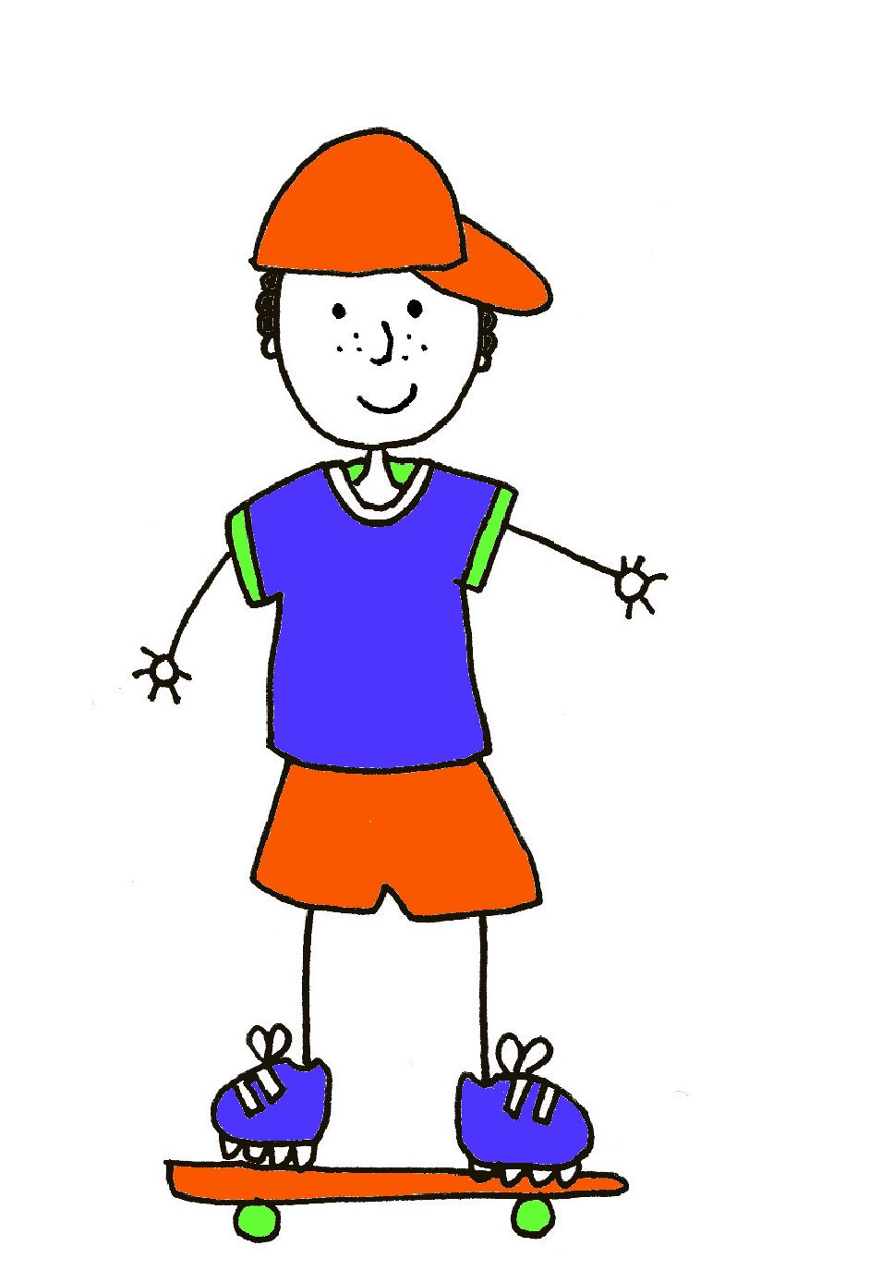
Le corps
1
2
4
3
5
6
7
8
9
10
Notes:
Ask pupils to name the parts of the body. The words do not come up – the coloured numbers give the gender clue.
1 = la tête 2 = les épaules (f) 3 = le bras 4 = le coude
5 = la main 6 = le doigt 7 = la jambe
8 = le genou 9 = l’estomac 10 = le pied

Slide 3
Va-t’en-grand monstre vert
https://www.youtube.com/watch?v=BwGzcbsaPyA

Slide 4
La tête est rouge.
Les yeux son jaunes.
Les dents sont verts.
Le nez est violet.
Les cheveux sont noirs.
La bouche est orange.
Les oreilles sont roses.
Notes:
Consolidation reading activity. More able pupils could do their own monster face and describe it for a partner to colour.

Slide 5
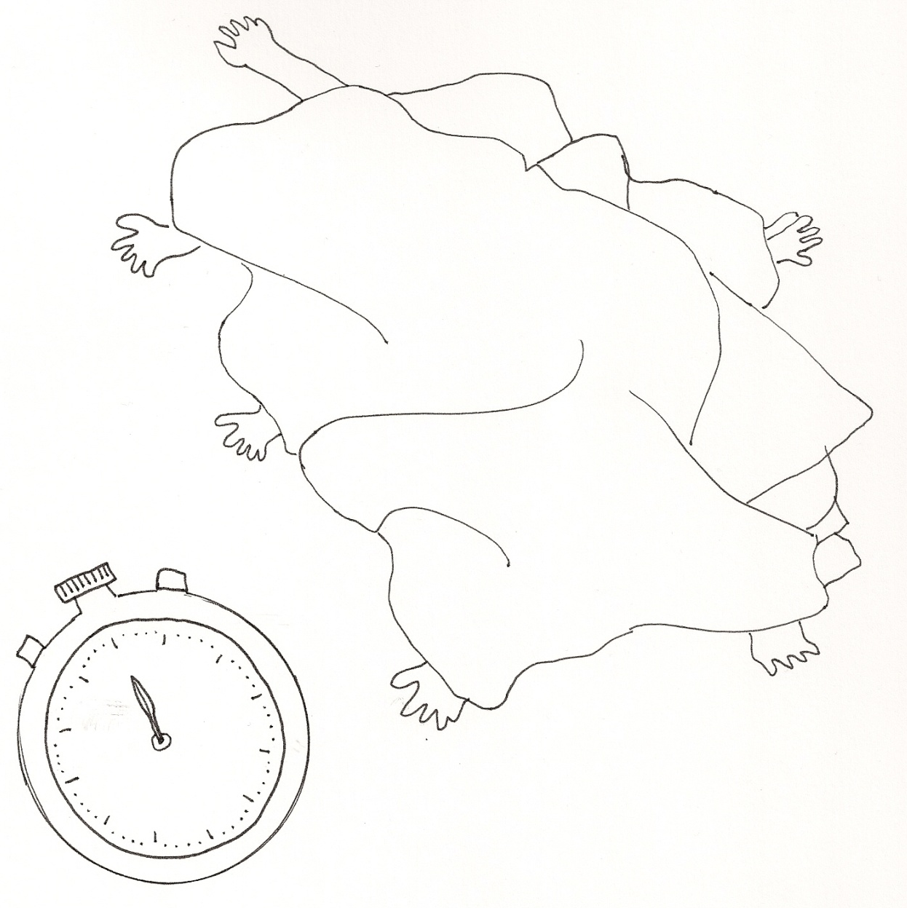
? | partie du corps
 | bras
 | genou
 | tête
 | mains
 | pieds
Notes:
Thank you to TES contributor McSquarkle for this game idea. 3 x pupils hide under a large blanket. Teacher or another pupil calls out a body part (either mains / bras / pieds / jambes / tete / doigts)
And the pupils have 5 x seconds to decide individually if to stick out one or two (not heads obviously!) of that body part. The rest of the pupils count up how many of the body part the monster has. For each group, a tally can be kept to show how many of each thing the monster has. If desired, the groups could then draw the monster that they have ‘physically’ designed under the blanket. Or, if preferred, they could design a completely new monster.

